Slide 1
How did the days of the week get their names?

Slide 2
Did you know…
In many languages all over the world the names of planets and the days of the week come from the names of ancient gods and goddesses that people believed in thousands of years ago.
The days of the week in the English language are named after the Sun, Moon and the planets and can sound very similar to what they used to be called all those years ago.

Slide 3
Sunday - named after the Sun
The Sun was the brightest thing in the sky and was worshipped by the Romans. Sunday was known as the Sun’s day.

Slide 4
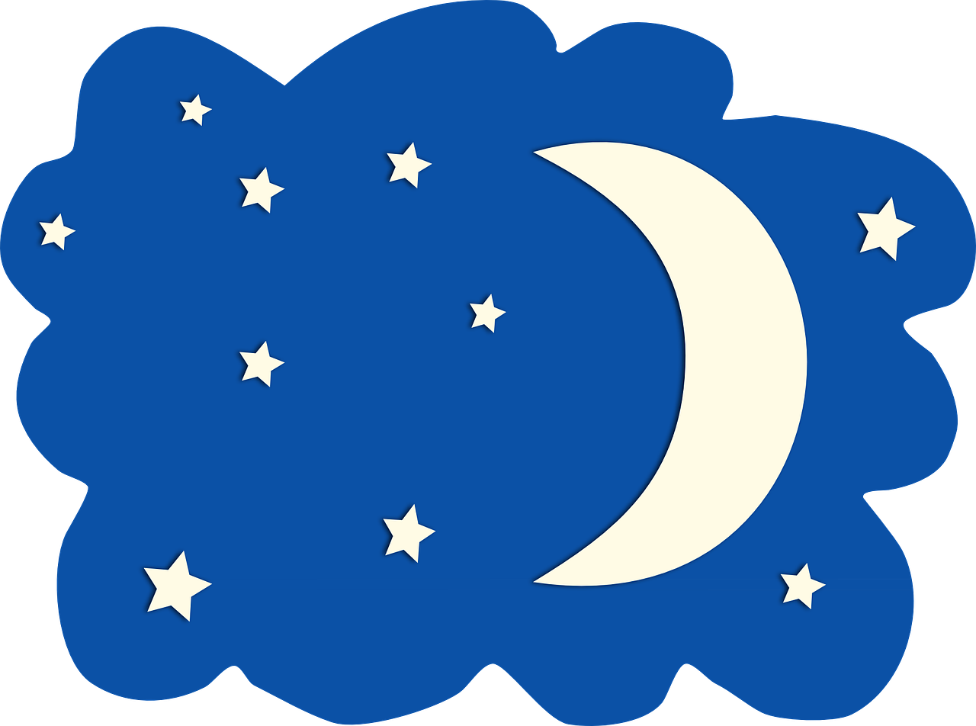
Monday - named after the Moon
When you look up to the sky at night you see the Moon – considered to be the second most important thing in the sky. Monday was known as the Moon’s day.

Slide 5
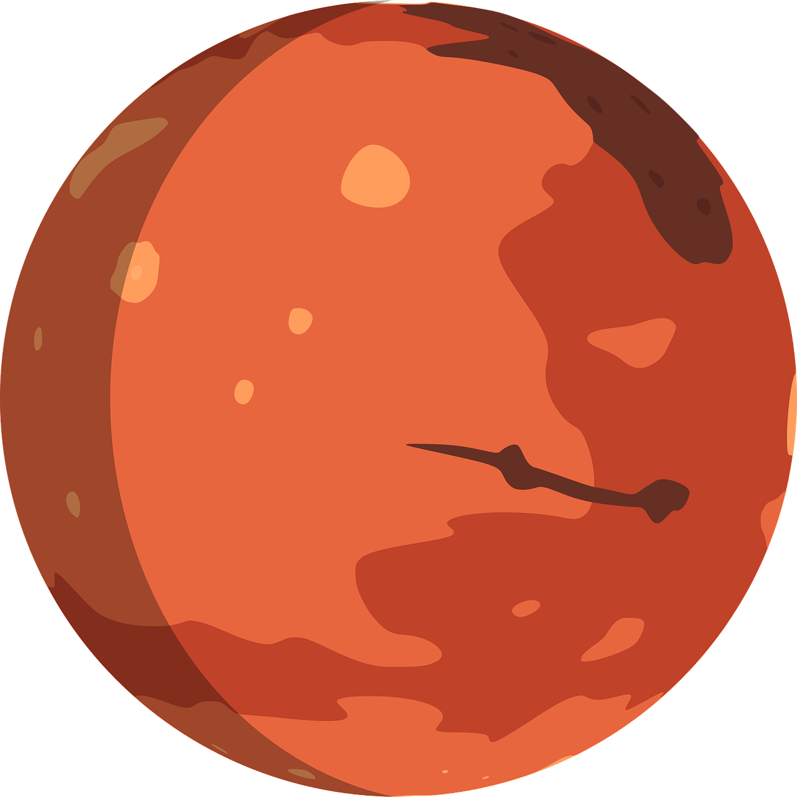
Tuesday - named after Mars
Mars was the god of war.
Tuesday was known as Tiu’s day - named after the Norse god of war.

Slide 6
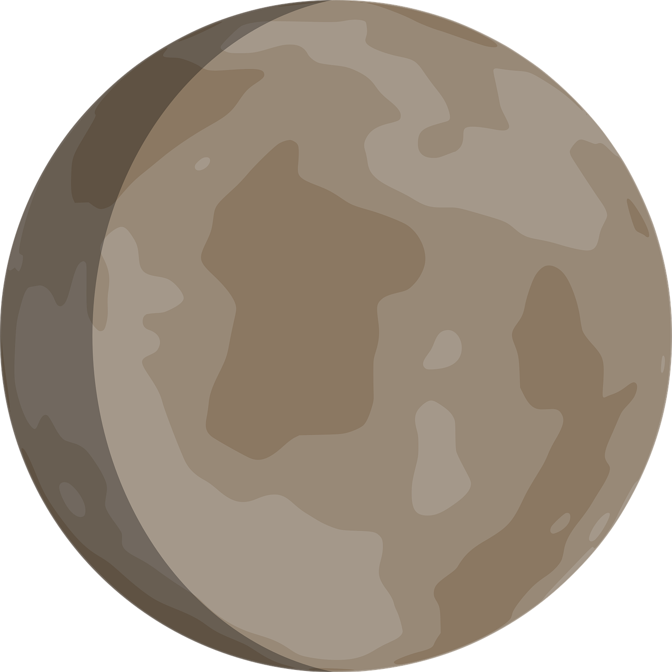
Wednesday - named after Mercury
Odin (sometimes referred to a Woden) was compared to Mercury.
Wednesday was known as Woden’s day.

Slide 7
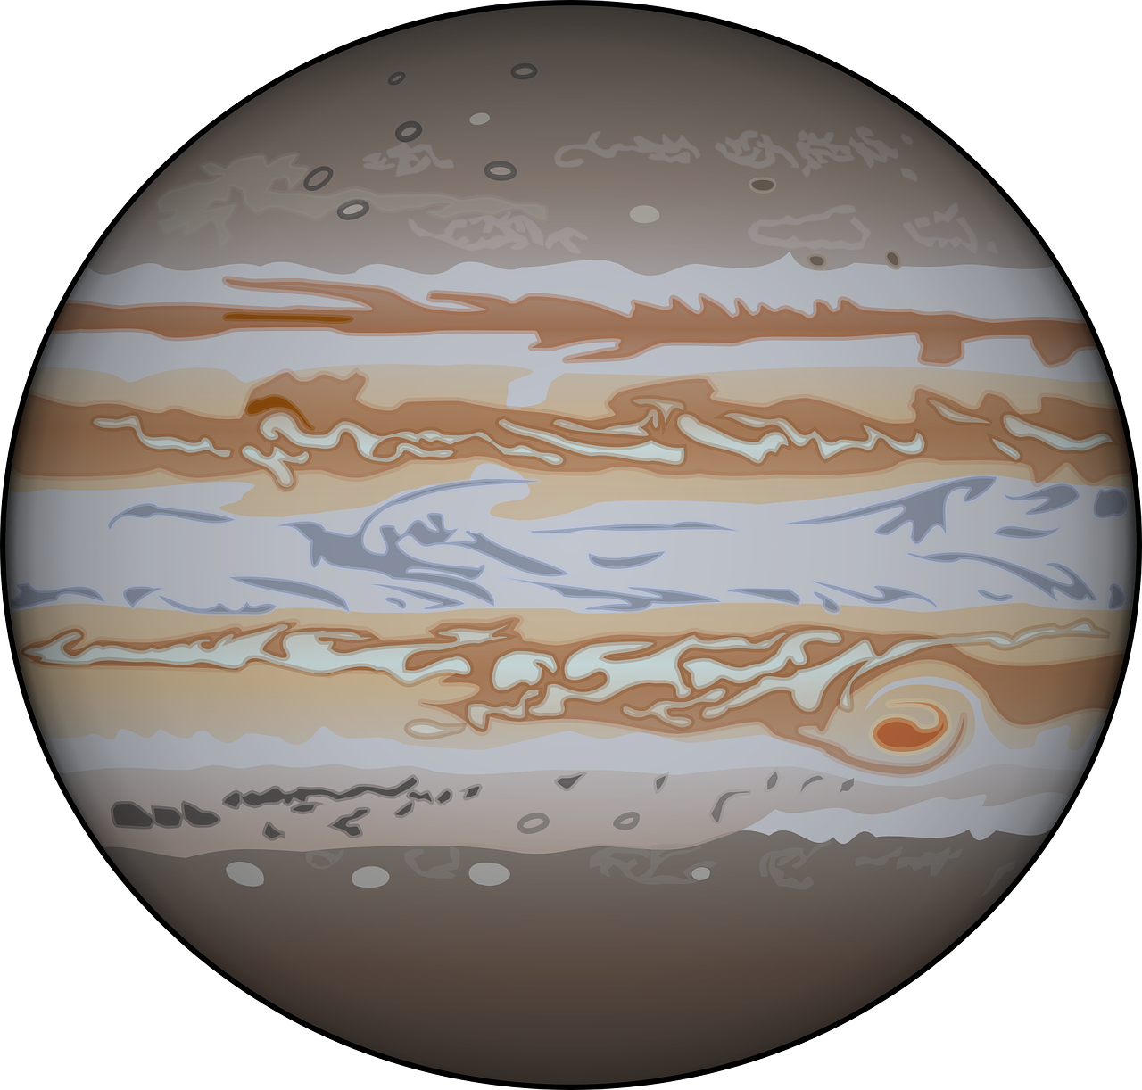
Thursday - named after Jupiter
Thor was often compared to Jupiter the Roman god of thunder.
Thursday was known as Thor’s day after the Norse god of thunder.

Slide 8
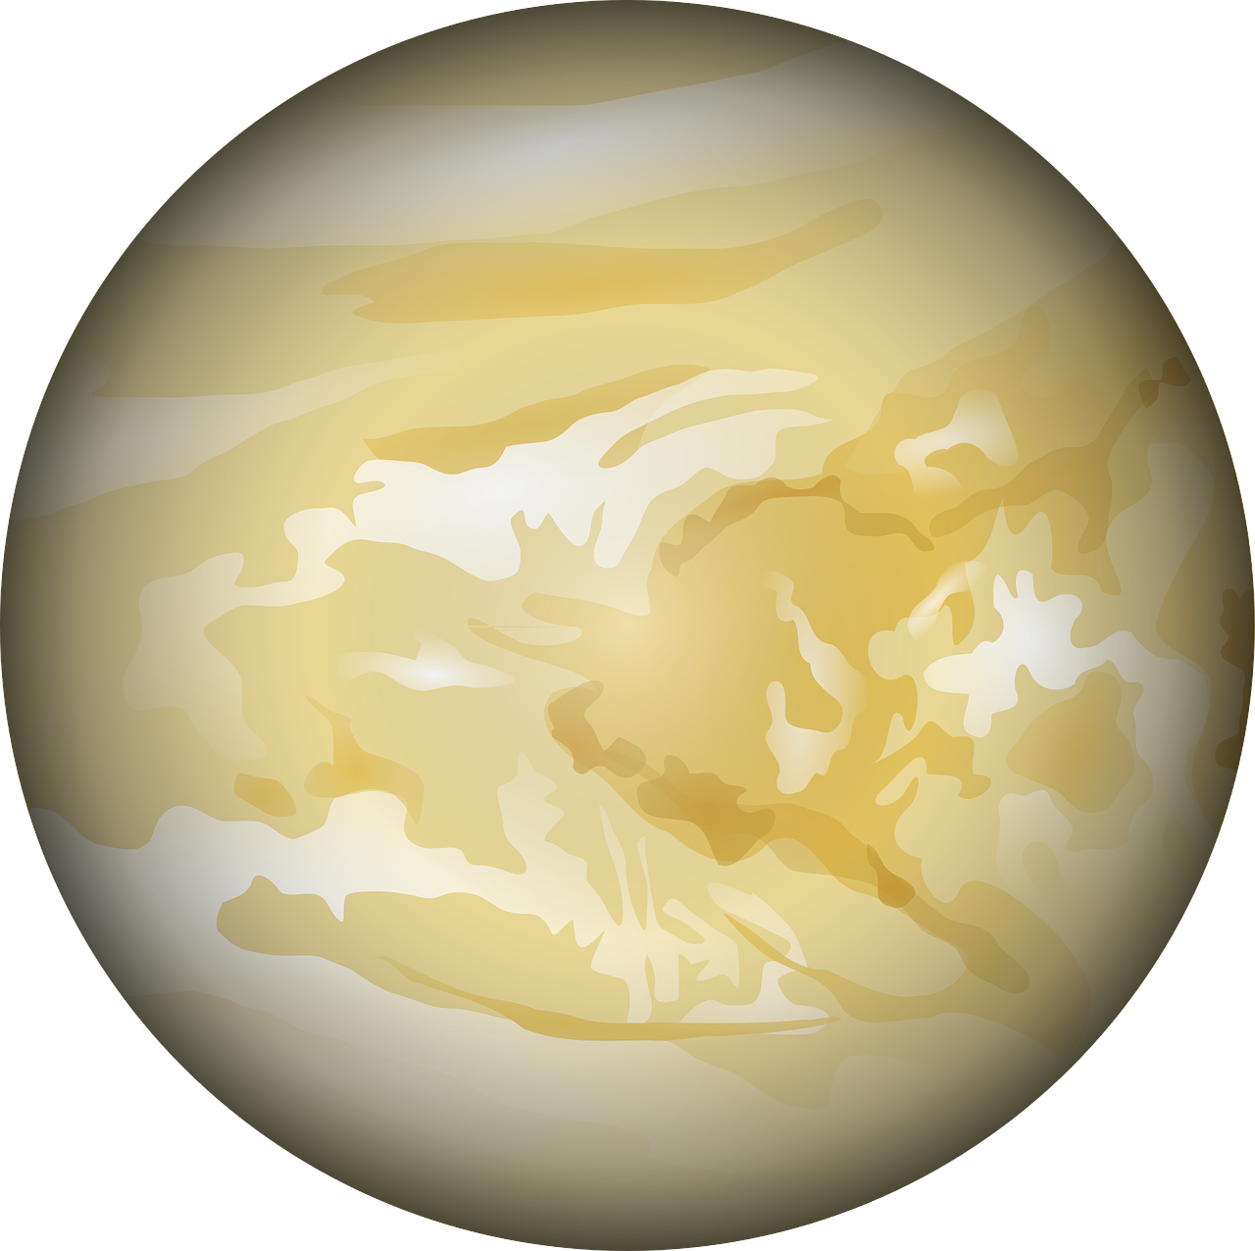
Friday - named after Venus
Venus was the god of love.
Frigg (sometimes known as Freya), was the female Norse goddess of love. Friday was therefore named – Frigg’s (Freya’s) day.

Slide 9
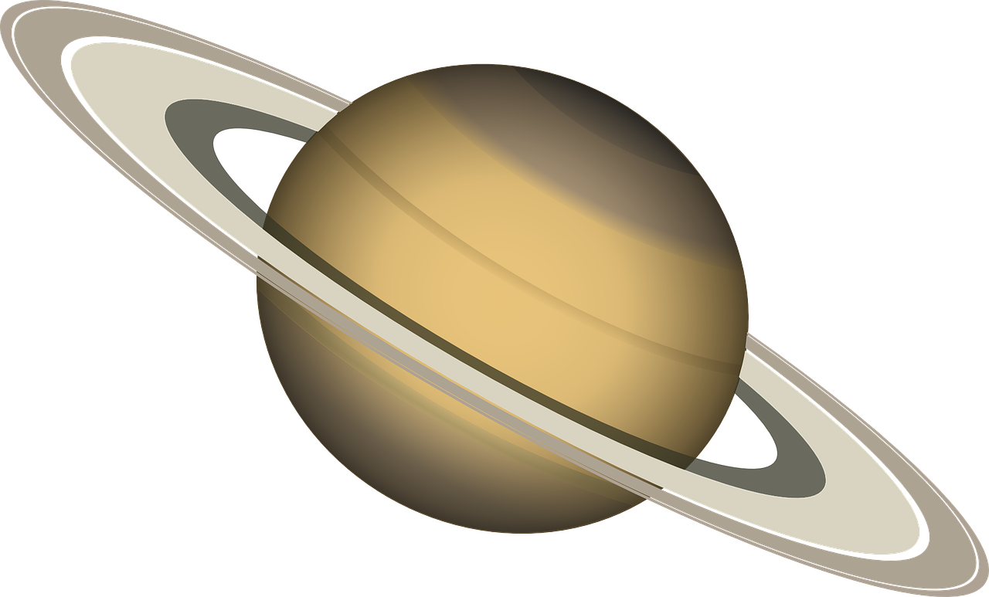
Saturday - named after Saturn
The English name Saturday comes from the Roman god Saturn. He was the god of wealth and agriculture.

