Slide 1
Science Root Words

Slide 2
Chlor-Green
Chlorine
Chlorophyll
Chloroform

Slide 3
Gen-Make
Genetics
Genealogy
Gene

Slide 4
Geo-Earth
Geography
Geoscience
Geocentric

Slide 5
Graph-Write
Photograph
Geography
Graphite

Slide 6
Astro-Star
Astrology
Astronaut
Astronomer

Slide 7
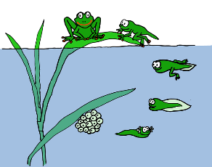
Bio-Life
Biology
Biodiversity
Neurobiology

Slide 8
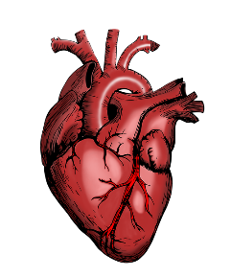
Cardi-Heart
Cardiac
Cardiology
Cardio

Slide 9
Heilo-Sun
Helios
Heliograph
Heliocentric

Slide 10
Hemo-Blood
Haemoglobin
Haemophilia
Haemorrhage

Slide 11
Hyper-Above
Hypertension
Hyperactive
Hyperthermia

Slide 12
Hypo-Below
Hypotension
Hypodermis
Hypothermia

Slide 13
Micro-Small
Microscope
Microwave
Microbiology

Slide 14
Macro-Large
Macroscopic
Macronutrients

Slide 15
Chrome-Colour
Chromium
Chromosome
Monochrome

Slide 16
Luna-Light
Lunar eclipse
Lunar calendar
Lunar lander

